Slide 1






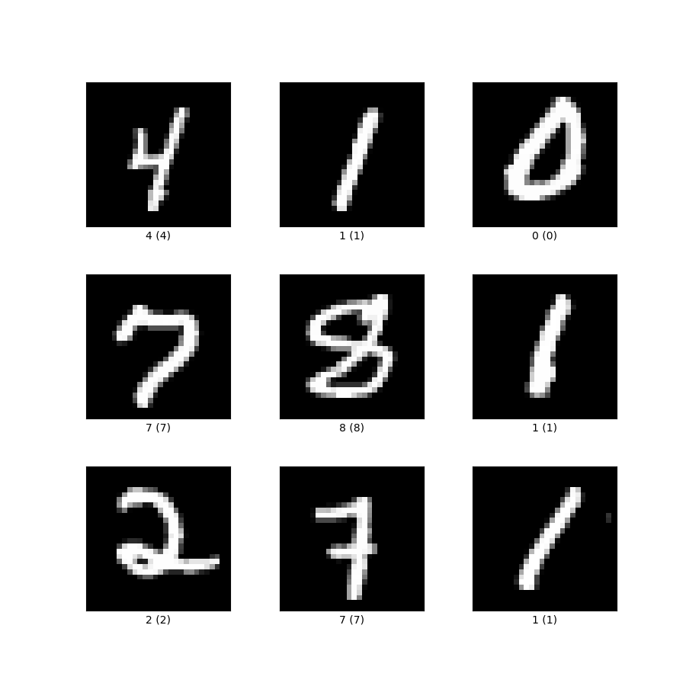
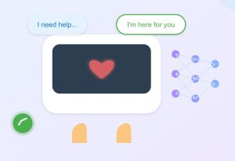
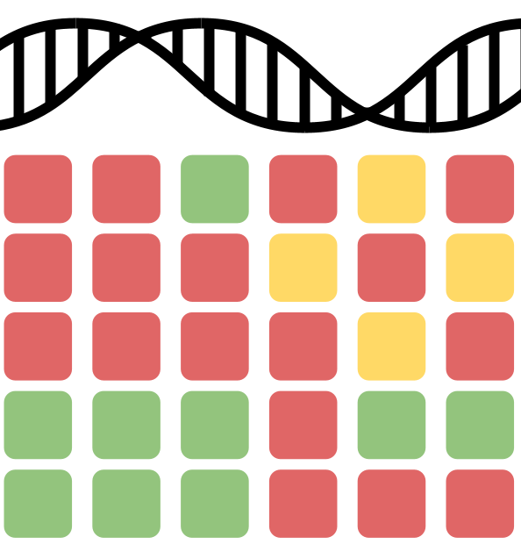

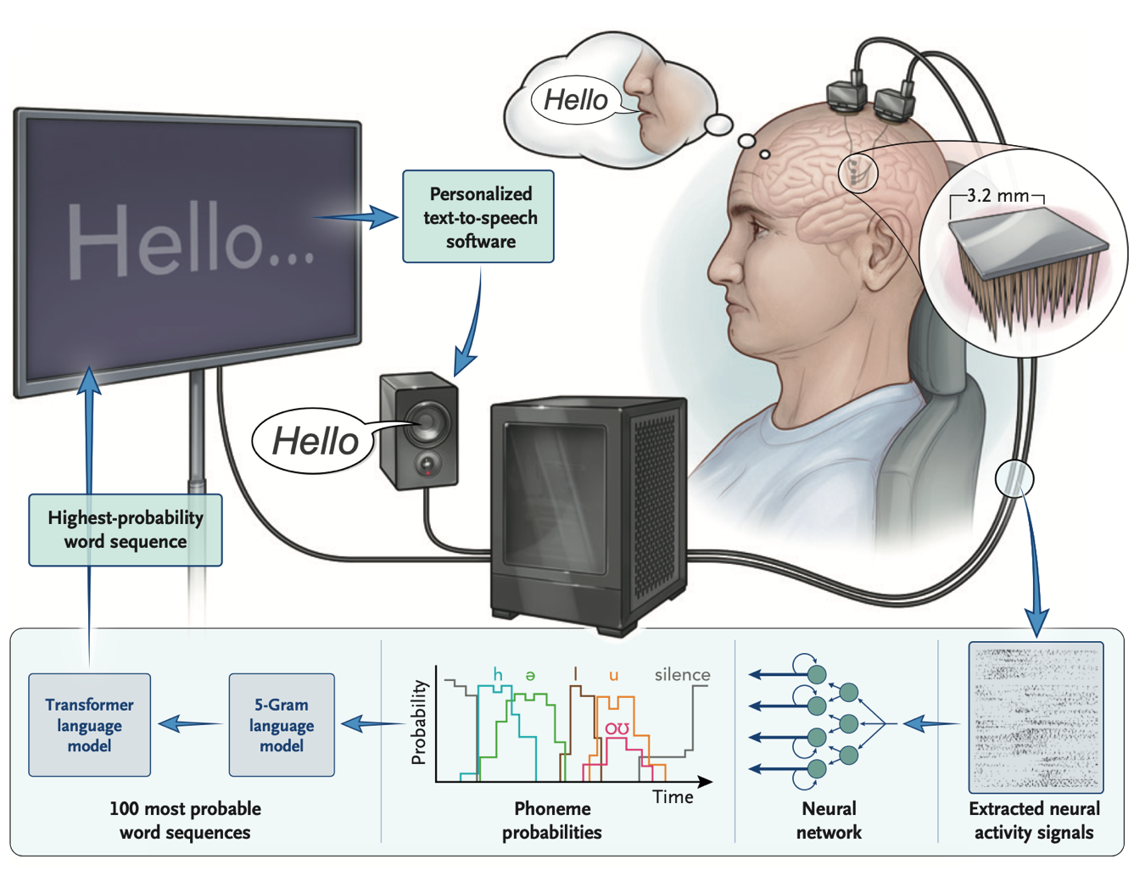


Welcome To The
Machine Learning Marathon 2025 (MLM25)!
Slides: go.wisc.edu/2et35u
Notes:
Welcome to our 3rd annual Machine Learning Marathon!
Chris Endemann
As of 2 months ago, I work as a Research Cloud Consultant at DoIT’s RCI office, where I help researchers at UW leverage cloud tools, especially for ML/AI workflows
Formerly a data science facilitator with the Data Science Hub, where and developed and taught AI focused workshops for researchers on campus, and launched the ML+X community back in 2021;
ML+X is an applied machine learning and & AI community, and brings together researchers, students, and industry members from across diverse fields. As of today, we have over 1000 subscribers.
we host talks, workshops, socials, and, of course, the annual ML marathon: https://ml-marathon.wisc.edu/

Slide 2
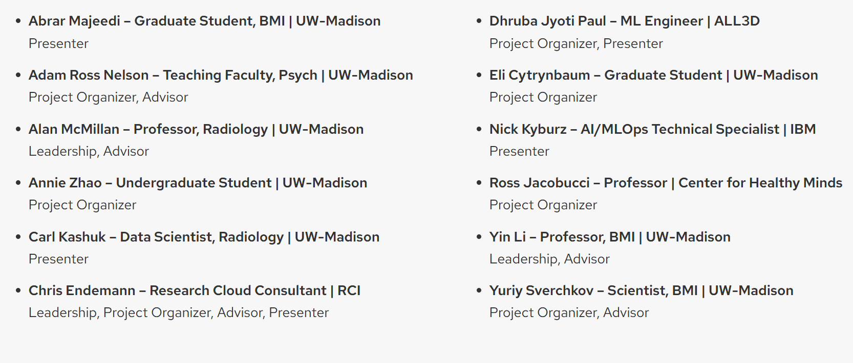
Thanks, Organizing Team!
Slides: go.wisc.edu/2et35u
Notes:
It takes a village to put together our annual MLM
thanks project organizers, presenters, advisors, and everyone else who contributed!

Slide 3




Thank You, ML+X Sponsors!
Thanks GCP for Extra Compute Power!
Notes:
Before we start, I would like thank our wonderful sponsors who have been very supportive for our community and our events.
If you’d like to find out more about sponsorship opportunities, please visit the link here to learn more

Slide 4
Tonight’s Agenda
Slides: go.wisc.edu/2et35u
Motivation
Logistics
Overview of projects
Find your team!
Resources for getting started

Slide 5
Motivation – Why MLM25
Slides: go.wisc.edu/2et35u
Rapid exposure to diverse methods and application areas. Sharing across projects sparks insights no single project could.
A testbed for real use cases: Challenges mirror ML/AI problems at UW–Madison, industry, and beyond
ML/AI is empirical: Real skill comes from applying methods to diverse datasets and problems, not from theory alone.
Career-building: A portfolio of projects opens doors of this field.
Community-driven: This isn’t a class — it’s collaborators building together. Lean on each other for help!
Shared failures & successes create skills and connections that outlast the hackathon.
Notes:
Why host a 3-month hackathon with 10 different projects? Why participate?
Half the battle in learnign something new is simply becoming familiar and gaining exposure. Here, you’ll quickly gain exposure
bring diverse groups together for interdisciplinary discussion
Not a class! Note about using slack for Qs instead of emailing Chris

Slide 6
MLM25 Code Of Conduct
Slides: go.wisc.edu/2et35u
Respect and Inclusivity: Encourage a diverse range of perspectives and backgrounds. Avoid offensive language or comments that might make others uncomfortable.
Be Patient and Supportive: Be patient with individuals who may not have as much experience. Offer assistance and mentorship when appropriate and requested.
Embrace the Kaggle Spirit! Participants should actively contribute to the community by sharing their work and insights (via Kaggle, Slack, meetings, etc.)
Feedback and Critique: Provide constructive feedback when necessary, but do so in a respectful and considerate manner. Be open to receiving feedback on your own work and ideas.
If you encounter any code of conduct violations, email me (endemann@wisc.edu). I will work with you to figure the next best steps.
Notes:
We will be adhering to the following code of conduct for this competition. Overall message: please be respectful of different backgrounds and experience levels.
If you encounter any code of conduct violations, please reach out to me at endemann@wisc.edu and I will work with you to figure the next best steps.

Slide 7
Rules
Slides: go.wisc.edu/2et35u
Team Size: The maximum team size is 5. Teams with only one member are highly discouraged, but some exceptions may be granted.
One Challenge Per Participant: To ensure efforts are not spread too thin.
Challenge Specific Rules: Be sure to review the “Rules” section of your chosen challenge to see if any additional rules may apply.
Attendance: Occasional absences (e.g., for exams or unavoidable conflicts) are understandable, but please be respectful of your fellow teammates and the commitment they’ve made to fully participating in MLM25.
Challenge Specific Rules: Be sure to review the “Rules” section of your chosen challenge (on Kaggle) to see if any additional rules may apply.
Notes:
All participants are expected to follow the rules detailed below.

Slide 8
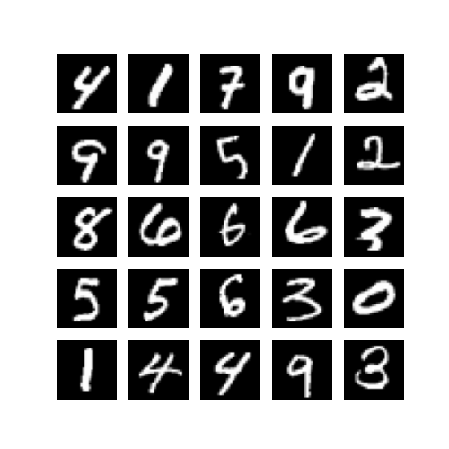
Digit Recognizer: Getting Started with Deep Learning
Slides: go.wisc.edu/2et35u
Goal: Build and train neural networks to recognize digits from image data, exploring core concepts like model architecture, loss functions, and evaluation. Teams are encouraged to implement solutions in multiple frameworks (e.g., PyTorch and Keras) to deepen their understanding and compare tooling. While this challenge is more study group than full-blown hackathon, it’s a strong foundation for more complex work in future semesters.
Prerequisites: Some experience with R or Python and machine learning basics
Methods: Deep learning and computer vision
Resources for Getting Started
Also see Intro to PyTorch & Intro to Keras
Organizer/Contact: NA (hosted by Kaggle). See Discussion tab from challenge page to get help.
Notes:
If you finish early in this challenge (e.g., by October, you can always join another project later)

Slide 9
WattBot: Estimating AI Emissions & Costs with RAG
Slides: go.wisc.edu/2et35u
Goal: In this challenge, teams will build a retrieval augmented generation (RAG) system that can reliably extract insights about AI’s environmental impact across 30+ academic papers and industry reports. The system must output citation-backed answers—or explicitly indicate when the evidence is missing from the provided corpus
Prerequisites: Prior exposure to NLP and deep learning is recommended. No prior experience with large language models (LLMs), RAG, or Hugging Face is required, but you must be willing to learn!
Methods: RAG, LLMs, Text mining, Deep learning, Optical character recognition (optional)
Resources for Getting Started
Organizer/Contact: Chris Endemann (endemann@wisc.edu)

Slide 10
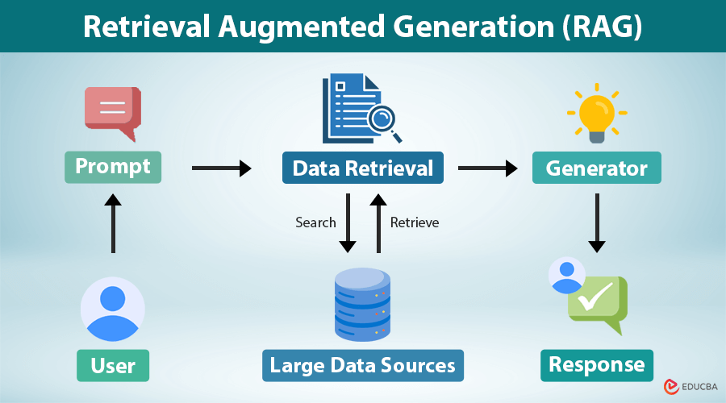
WattBot: Estimating AI Emissions & Costs with RAG
Slides: go.wisc.edu/2et35u
Given a question, use a large language model (LLM) to scan corpus/docs for relevant info (quotes, figures, tables, etc.)
Then, generate an answer using the retrieved info as context. This helps prevent “hallucinations” and makes responses grounded by citable materials.
https://www.educba.com/retrieval-augmented-generation/

Slide 11
Some questions are simple quote lookups
Slides: go.wisc.edu/2et35u
True or False: New AI data centers often rely on air cooling due to high server power densities.
Answer: FALSE.
Supporting refID(s): [li2025b]
Supporting material(s): [“In general, new data centers dedicated to AI training often rely on liquid cooling due to the high server power densities.”]
Notes:
Small sample of questions(with answers) are available to help teams calibrate the RAG systems.
some are simple quote lookups

Slide 12
Some questions require reasoning or simple math.
Slides: go.wisc.edu/2et35u
How many U.S. household-years of electricity consumption is training a 6.1B-parameter language model equivalent to?
Answer: 1.3 household-years.
Supporting refID(s): [dodge2022, strubell2019]
Supporting materials: [“The 6.1B parameter model consumed 13.8 MWh.”; “Average U.S. household consumption ≈ 10,715 kWh/yr.”]
Reasoning: 13.8 MWh ÷ 10.7 MWh/yr ≈ 1.3 household-years of electricity.
Notes:
Small sample of questions(with answers) are available to help teams calibrate the RAG systems.
some are simple quote lookups

Slide 13
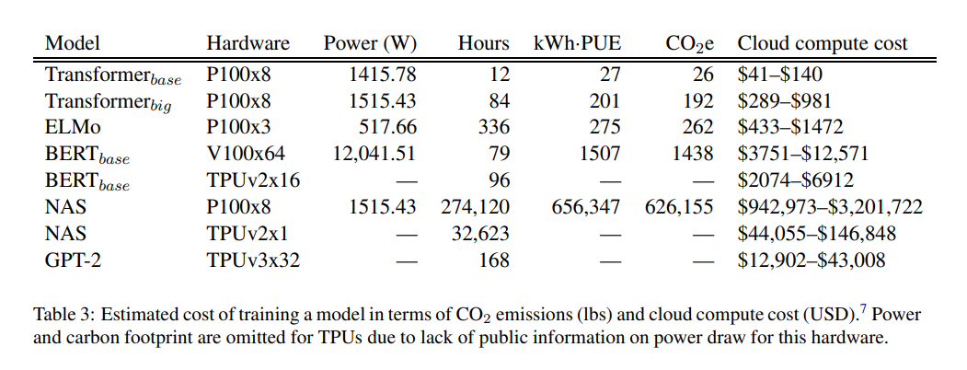
Slides: go.wisc.edu/2et35u
Some questions require you to properly parse table data from PDFs
What is the estimated CO2 emissions (in pounds) from training the BERT‑base model for 79 hours on 64 V100 GPUs? Answer: 1438 lbs. Supporting refID(s): [strubell2019], Supporting materials: Table 3.
https://arxiv.org/abs/1906.02243
Notes:
Some questions your system to accurately parse PDF tables

Slide 14
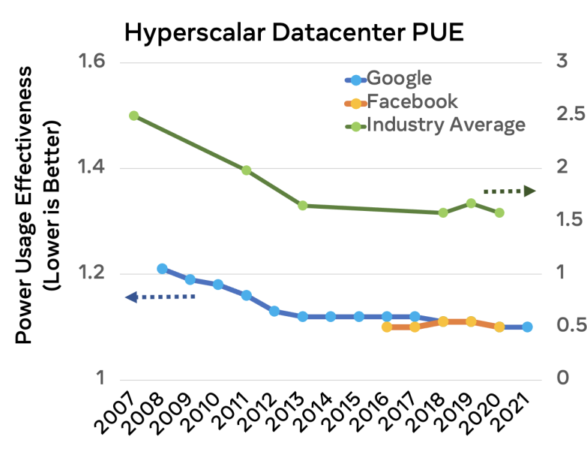
Slides: go.wisc.edu/2et35u
Some questions require visual reasoning over figures
True or False: In 2020, Power Usage Effectiveness (PUE) values reported by Google and Facebook (~1.1) were lower than the industry average by about 40%. Answer: TRUE. Supporting refID(s): [wu2021b], Supporting materials: [Figure 1]
https://arxiv.org/abs/2108.06738
Notes:
A small portion of questions involve visual reasoning — for example, interpreting a graph to extract values.
PDF parsers or Optical Carachter Recognition (OCR) techniques may be needed to accurately read data from graphs
(note that evidence-based retrieval has its flaws - have to trust sources)

Slide 15
Slides: go.wisc.edu/2et35u
Some questions are intentionally out-of-scope. System must respond appropriately.
What was the total electricity consumption of all Google Cloud TPU pods worldwide in 2023, in megawatt-hours?
Answer: Unable to answer with confidence based on the provided documents.
Supporting refID(s): [is_blank]
Supporting materials: [is_blank]

Slide 16

MaveDB amino acid substitution prediction
Slides: go.wisc.edu/2et35u
Goal: Predicts the outcomes of Multiplexed Assays of Variant Effects (MAVEs). Given an amino acid substitution in a protein, you will predict the measurement of protein function that one would get if the protein were assayed in the lab.
Prerequisites: General ML understanding, familiarity with deep learning highly recommended, experience using Hugging Face is a plus.
Methods: Deep learning, Foundation models, Zero-shot prediction, Protein language models, Regression
Resources for Getting Started
The huggingface model hub is a great resource for accessing pre-trained models
Zero-shot classification: Using large pre-trained models on novel tasks. These resources are written with a focus on LLMs, but many of the same ideas apply to protein language models.
ESM Cambrian: a state-of-the-art protein language model.
Organizer/Contact: Yuriy Sverchkov (sverchkov@wisc.edu)

Slide 17
MaveDB amino acid substitution prediction
Slides: go.wisc.edu/2et35u
Methods: A promising approach to this problem would be to use a trained “foundation” protein language model and use it as a feature generator for a trained ML “head.”
Proteins
Proteins are the molecular machines that living cells rely on
Made up of chains of amino acid residues
Can be represented as a sequence of symbols, where each symbol represents an amino acid: MPLYSVTVKWGKEKFEGVELNTDEPPMVFKAQLFALTGVQP
What happens to the protein’s function if one of the amino acid residues is substituted for another?
Protein Language Models
Just as LLMs can model language as a sequence of tokens, PLMs can model proteins as sequences of amino acids
Have been used for variant effect prediction and protein engineering

Slide 18

CrisisCompanion: Creating a Mental Health Support Chatbot
Slides: go.wisc.edu/2et35u
Goal: In this challenge, you’ll explore how generative AI can be responsibly applied to the development of mental health support chatbots. You’ll work with a range of publicly available datasets—from counseling transcripts to emotion classification corpora—to build and evaluate a conversational agent that can provide basic, non-clinical support.
Long-Term Goal: A deployable, real-time chatbot used in suicide prevention studies.
Oriented to suicide research (Needs to be able to discuss suicide)
Deployable in a restricted data environment
Understands its limits 6
Notes:
Open ended! Not hosted on Kaggle. See project page for some datasets you can explore to help with this task.

Slide 19
CrisisCompanion: Creating a Mental Health Support Chatbot
Slides: go.wisc.edu/2et35u
Quick Start Recommendations:
See Hugging Face’s transformers quick start
Go through chatbot and building LLM tutorials
Qwen3 is a good starting place for an LLM
Organizer/Contact: Ross Jacobucci (jacobucci@wisc.edu)
Prerequisites: None – Use Claude/ChatGPT/Gemini to get started
Notes:
Open ended! Not hosted on Kaggle. See project page for some datasets you can explore to help with this task.

Slide 20
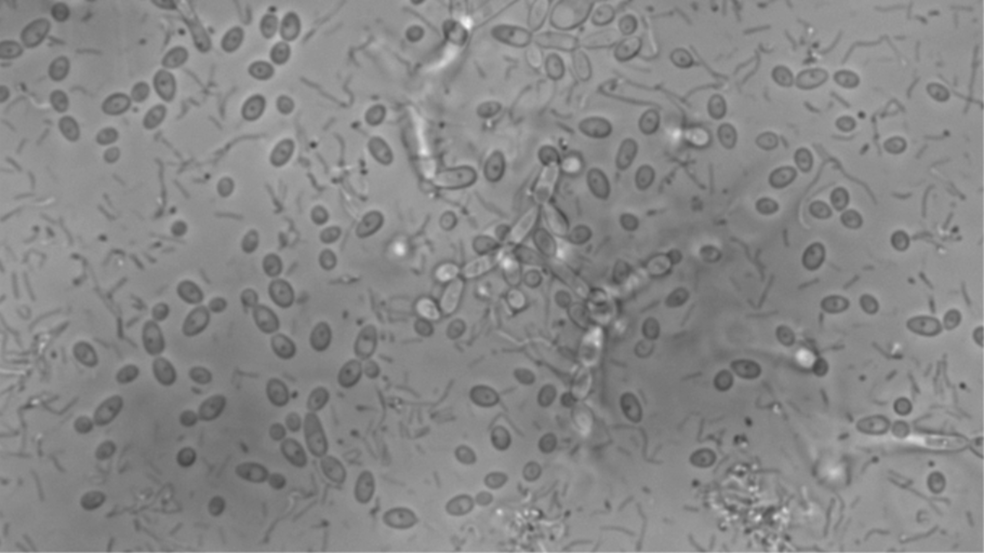
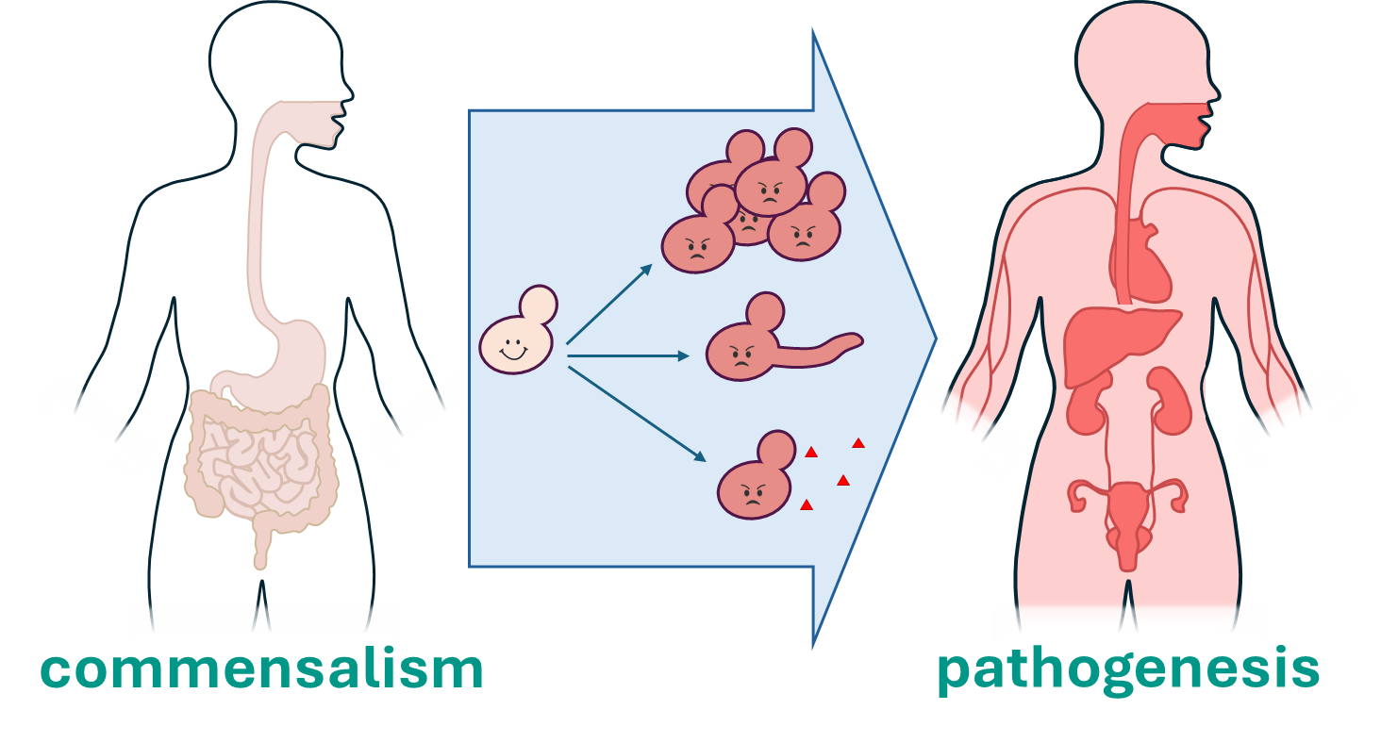
Cellular state image analysis
Slides: go.wisc.edu/2et35u
Goal: Identify cells in different cellular states within time-lapse microscopy images.
Background: Candida albicans is a fungal opportunistic pathogen in which both commensal and pathogenic behavior relies heavily on transitions between cellular states including yeast-form and hyphal cells and community organizations including dispersed cells and biofilms.

Slide 21
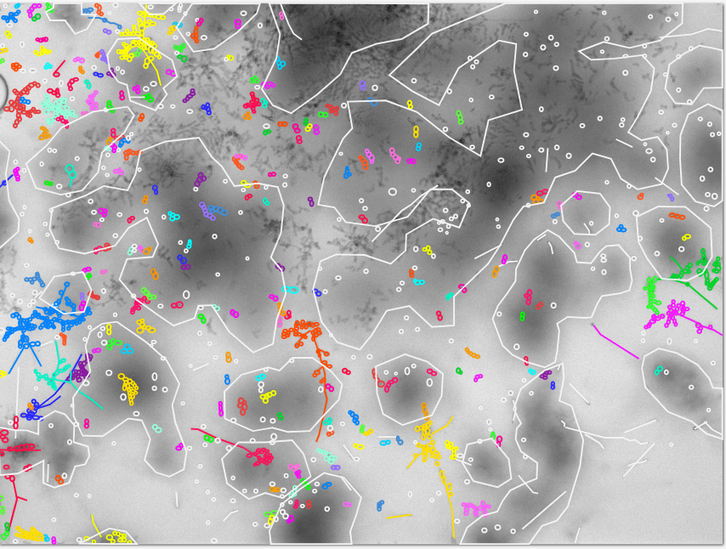
Cellular state image analysis
Slides: go.wisc.edu/2et35u
Teams will be supplied with annotated and unannotated time-lapse images of developing and dispersing Candida albicans biofilms.
Annotations include specification of:
cell type
cell dimensions
groups of adherent cells.
Teams will use this data to create programs to:
identify cells
classify cells
track cells
Organizer/Contact: Eli Cytrynbaum (cytrynbaum@wisc.edu)

Slide 22
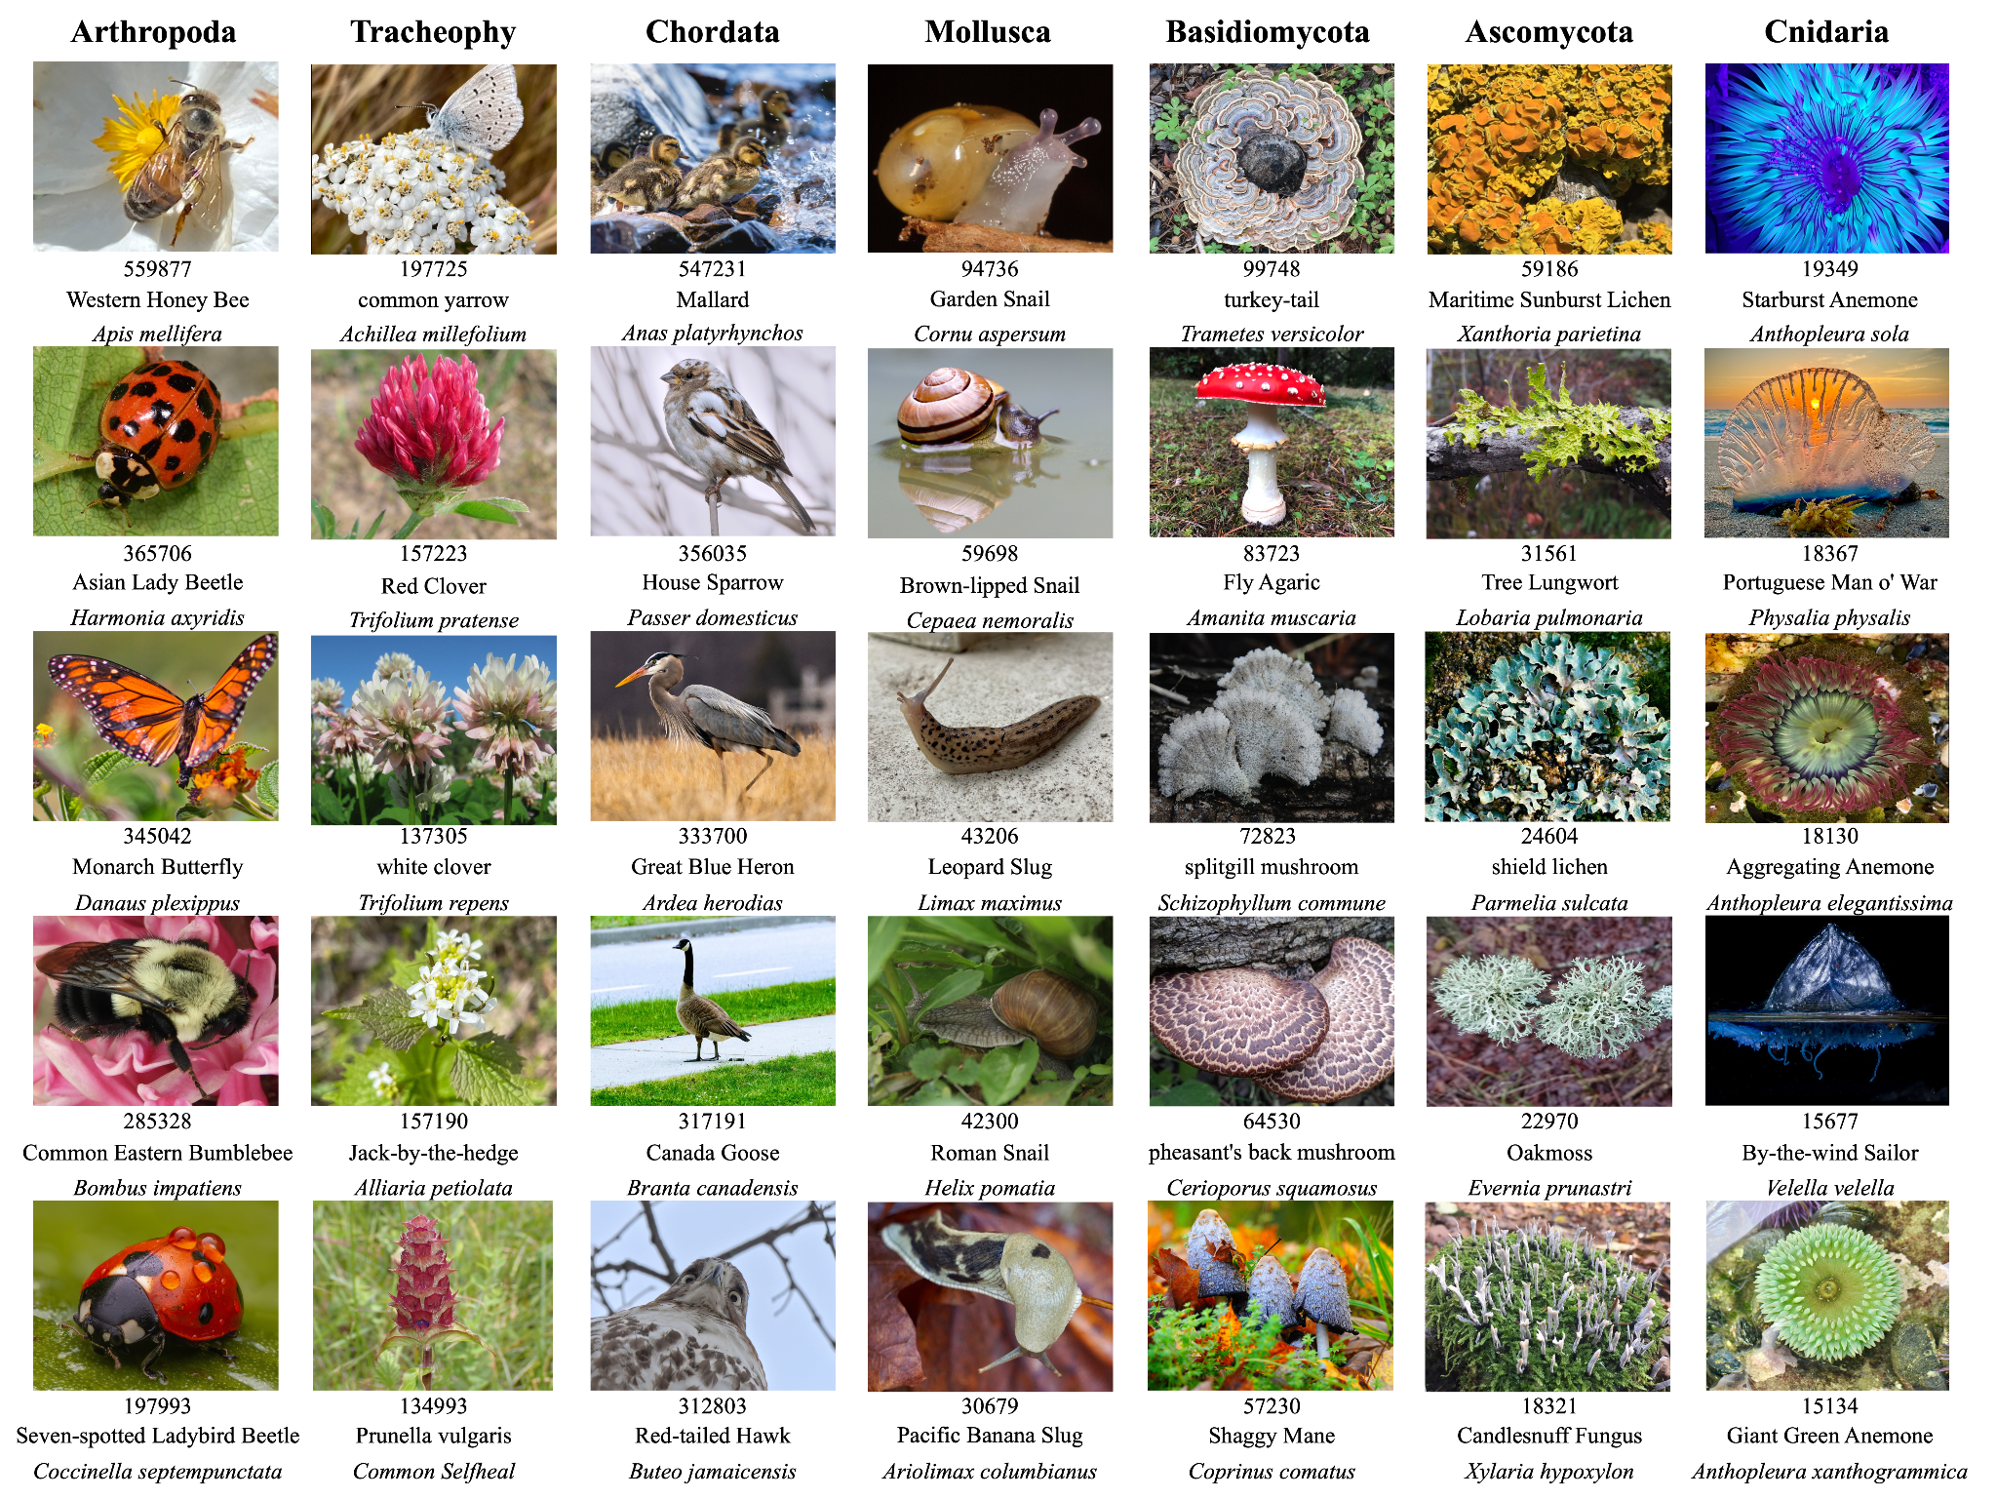
Clustering the BioTrove Dataset
Slides: go.wisc.edu/2et35u
Goal: In this challenge, you’ll work with a ~50,000-image subset of BioTrove spanning the tree of life. Your task is to learn clusters from image features (with optional family-level taxonomic labels) that approximate the hidden biological taxonomy. Evaluation is based on how well your clusters match hidden genus- and species-level groupings, measured using Normalized Mutual Information (NMI).
Prerequisites: Familiarity with neural networks and CNNs is expected. You don’t need to know contrastive learning or autoencoders beforehand, but these methods are encouraged and can be learned during the challenge.
Methods: Contrastive learning (e.g., SimCLR, SupCon), autoencoders, image embeddings, hierarchical clustering, CLIP-style models (optional), dimensionality reduction.
Resources for Getting Started
Organizer/Contact: Chris Endemann (endemann@wisc.edu)
Notes:
Contrastive learning is useful in a couple of different contexts; (multimodal learning or learning embeddings without fine-grained labels; also has been shown to improve clustering results)

Slide 23
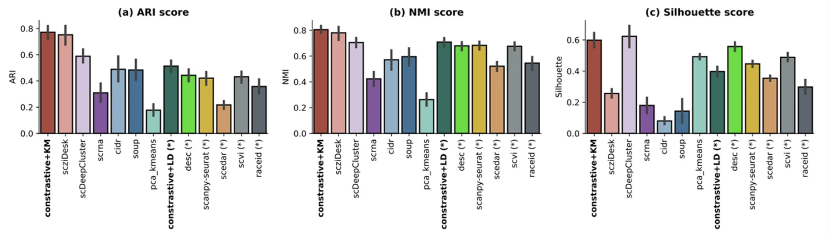
Contrastive Learning Has Been Shown To Improve Clustering Results - Evaluation on 15 real datasets
Autoencoders also work well (scDeepcluster and scziDesk)
Ciortan, M., & Defrance, M. Contrastive Self-supervised Clustering of scRNA-seq Data. BMC Bioinformatics, 2021.
Notes:
Real scRNA-seq data analysis. A method comparison has been performed across all 15 real datasets in terms of ARI—Adjusted Rand Index (a), NMI—Normalized Mutual Information (b), Silhouette (c), Calinski (d) scores, the execution time (e) and the error of the predicted number of clusters (f). The execution time and the Calinski scores have been depicted in log scale. The error as the relative difference between the predicted and the true number of clusters [(pred − true)/true)] is illustrated in f. The methods annotated with (*) indicate those where the clustering was performed without inputting the number of clusters. All methods in this category tend to overestimate the number of clusters in the data and do more so in the imbalanced setting. For each dataset and method, three runs have been performed
Adusted Rand Index (ARI) ARI measures the similarity between two clusterings by focusing on pairs of points. It checks how consistently pairs of samples are assigned to the same or different clusters in both the predicted and true clusterings.
Normalized Mutual Information (NMI) measures the amount of information shared between the predicted and true clusterings. computes the mutual information (MI) between the true and predicted labels, then normalizes it (usually using the average entropy of the true and predicted labels) to ensure values are in a consistent range.
NMI can be more reliable when working with imbalance data .
scDeepCluster: This method enriches a deep count autoencoder model with a clustering layer. Although it achieves high Silhouette scores in some cases, this does not always align with ground truth. scDeepCluster appears to have a high Silhouette score on average across dataset
scziDesk: Another autoencoder method
• Methods that infer number of clusters automatically (frequently overestimate!): Leiden (LD), Scanpy, desc, scedar, raceid, scVI
Leiden community detection: This algorithm does not require a pre-defined number of clusters. Instead, it infers the number of clusters dynamically based on data density and connectivity criteria. It performs community detection by optimizing modularity on the cell's neighborhood graph.
Seurat (using the Scanpy implementation): This method performs cell-community detection using the Louvain algorithm, which infers the number of clusters automatically.
desc, scedar, raceid, and scVI: These methods also perform clustering without needing the number of clusters as an input.
Note: Silhouette isn’t always so reliable…

Slide 24

Store Sales: Time Series Forecasting
Slides: go.wisc.edu/2et35u
Goal: This challenge introduces core forecasting techniques through a real-world dataset: predicting future sales across multiple retail stores. Participants will explore temporal patterns, seasonality, and exogenous variables to build forecasting models that generalize well over time.
Prerequisites: Basic ML and deep learning foundations are helpful here. No experience with time-series modeling is assumed.
Methods: Classical forecasting (e.g., ARIMA), machine learning approaches (e.g., XGBoost), and deep learning methods for sequence prediction. Optional exploration of holiday effects and promotions.
Resources for Getting Started
https://www.kaggle.com/learn/time-series
Organizer/Contact: NA (hosted by Kaggle). See Discussion tab from challenge page to get help.

Slide 25
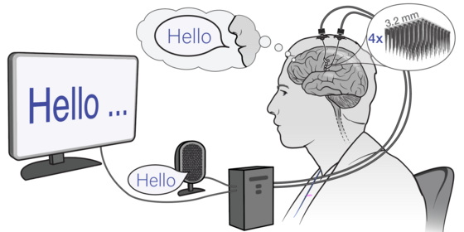
Brain-to-Text '25: Decoding Neural Signals to Speech
Slides: go.wisc.edu/2et35u
Goal: Foster the development of new and improved algorithms for decoding speech from brain activity. Improved accuracies will make it more likely that a speech brain computer interface (BCI) can be clinically translated, improving the lives of those with vocal tract paralysis
Prerequisites: Foundational knowledge of deep learning is expected. Some familiarity with signal processing or time-series modeling is recommended. No neuroscience background is required.
Methods: Signal processing, time-series modeling, spiking neural data, sequence-to-sequence learning, speech decoding, RNNs or transformers, word error rate (WER) evaluation.
Organizer/Contact (external): https://www.kaggle.com/notnickc
Also see Discussion tab on Kaggle
Notes:
Note: Click challenge name to visit URL for challenge)
Decode brain activity into words
Dataset: ~11k sentences with paired neural recordings from single participant + intended text (train/val)
Test set: neural data only — predict intended sentences
Scored by word error rate (WER)
Goal: improve speech BCIs for people who cannot speak
Less guided than other challenges - more competitive
advisors and myself are happy to provide tips and suggestions, but we don’t have very many pre-baked resources for getting started on this challenge.
Will require some confidence in basic machine learning and deep learning. Transformer models may be needed to extract good embeddings from the time series data.

Slide 26
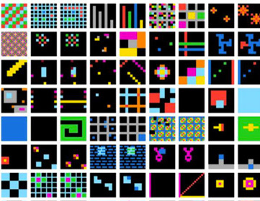
Advanced Reasoning Corpus (ARC) 2025
Slides: go.wisc.edu/2et35u
Goal: Build AI systems that can learn and apply abstract visual reasoning rules from just a few examples, in order to generalize to completely novel problems. Every test task has rules not seen in training. Foundation models excel at interpolation within their training distribution, but ARC is intentionally out-of-distribution.
Prerequisites: For highly advanced participants only. This challenge assumes a high degree of fluency with deep learning frameworks, foundation models, and programmatic reasoning techniques. Participants should be confident exploring advanced, open-ended modeling workflows with minimal guidance.
Methods: Vision Transformers, Few-shot learning, CoT prompting, Reinforcement learning, Pattern transformation logic, Algorithmic reasoning
Resources for Getting Started: None. You will be expected to conduct your own research to figure out solutions.
Notes:
Not much (any) advisor support for this challenge!

Slide 27

Survey Responder
Slides: go.wisc.edu/2et35u
Goal: Investigate if the output from one LLM model may differ from the output of another LLM chat model.
Prerequisites: Knowledge or experience in core machine learning methods (Knn, SkLearn, predictive analytics generally) is optional. The core analytical question for this project is descriptive / or inferential.
Also probably helpful will be: Familiarity with LLMs (e.g., via Ollama or AnywhereLLM) and basic survey research or psychometric principles is recommended.

Slide 28
Survey Responder
Slides: go.wisc.edu/2et35u
Methods: Inferential statistics (t-tests, or regression with binary independent variables).
Resources for Getting Started:
The GitHub Repository
Previous Response Results
Supplemental Project Description
Organizer/Contact: Adam Ross Nelson (UW’s Data Science for Human Behavior, and the Wisconsin Undergraduate Research in Data Science Programs).
WISCURDS: dsi.wisc.edu/wiscurds

Slide 29
Slides: go.wisc.edu/2et35u
Questions?
Notes:
(about WattBot or any of the challenges)

Slide 30
Networking Time – Find Your Team :)
Slides: go.wisc.edu/2et35u
Find signs around the room indicating different challenges
Share with others…
Your goal(s) for participating in MLM25
Why you’re interested in your selected challenge
Your previous experience working on ML projects
How many hours/week you realistically expect to commit
Anything else you’d like to share
Team registration due by 9/18, but aim to complete it tonight
https://forms.gle/UrmRK7q3CZjuqUZz6 – Only ONE person from each team should fill out the form
Incomplete teams should also register if struggling to find members – we’ll share a spreadsheet of incomplete teams to Slack by Monday

Slide 31
ML+X Nexus: Crowdsourced Resources
go.wisc.edu/68h67v
Slides: go.wisc.edu/2et35u
Community GitHub repo and website for community members to share and contribute ML resources
Resource = anything that can make ML practice more connected, accessible, efficient, and reproducible
External or original
Includes educational materials, applications & stories, ML tools, and more
Notes:
Navigating and Contributing to ML+X Nexus: Crowdsourced ML and AI Resources ML+X Nexus is the community’s centralized hub for sharing machine learning (ML) resources, designed to make ML practice more connected, efficient, accessible, and reproducible. It is intended to host a wide range of resources, including educational materials, code for common ML procedures, pretrained and foundational model use guides, recorded talks, and more. While practitioners can use Nexus to expand their expertise, educators and PIs will find it invaluable for sharing ML knowledge and procedures across fields, reducing redundancy, and improving learning outcomes. In this session, you'll learn how to navigate and contribute to Nexus, which already includes resources like the “Intro to Deep Learning with Keras” workshop and guides on "Out-of-Distribution Detection." We’ll also discuss future areas of development, such as our member blog section, contrastive learning and trustworthy AI, and how you can get involved through our GitHub. Don’t miss this chance to connect with the community and make your work more impactful!

Slide 32
ML+X Nexus: Crowdsourced Resources
go.wisc.edu/68h67v
Slides: go.wisc.edu/2et35u
How to contribute?
Create an issue announcing your plan to add a resource — see ML+X Nexus Issues
Fork the ML+X-Nexus repository
Clone the forked repository onto your local machine
Create a new branch
Write the post, commit and push the changes
Make a pull (merge) request
Link to slides: go.wisc.edu/52ya98

Slide 33
Resources for Getting Started: Kaggle Notebooks
See Kaggle’s documentation for more information: kaggle.com/docs/notebooks
Slides: go.wisc.edu/2et35u
View your Kaggle notebooks
Code → Your Work
Open a notebook
Code → New Notebook
Upload data to notebook
Add Data → Search for your challenge
Switch from notebook to script
File → Editor type
Download code
Click the vertical three dots and select "Download code"
Save notebook often!
Save version → Name_YY-MM-DD_HHMM
Share notebook
Share → Add collaborators
Can I work on a notebook with someone else live?
No, collaborators won’t see updates until you save a new version
You can sync kaggle notebooks with Git, however
Notes:
Later in October, we will also share instructions for using AWS credits to scale up your computational experiments. Limited credits provided free of charge.

Slide 34
Cloud Resources
Slides: go.wisc.edu/2et35u
Minimum of $50 in AWS/GCP compute credits per person. You can apply for more based on project needs.
AWS Workshop on Oct. 9th, 4:30-7:30pm
GCP Workshop on Oct. 30, 4:30-7:30pm
You’ll need to pass a short quiz showing that you are familiar your preferred cloud vendor before gaining access. Workshop materials will be provided.
Notes:
Who here already knows how to do ML/AI with AWS? How about GCP?
Can anyone not show up by 4:30 on the 9th or 30th?

Slide 35
Other Resources
Slides: go.wisc.edu/2et35u
Advisor assigned to each challenge starting next week
Full hackathon community (#mlm25): We encourage you to post your questions to our Slack channel, #mlm25 (make sure to join Slack group first)
Kaggle/learn: Kaggle provides many tutorials and notebooks on various ML topics
ML+Coffee ( 9-11am; 1145 Discovery Building): Monthly social & coworking event with other ML practitioners. Plus free coffee/tea! Our next session is Oct. 9-11am. Sign up to discuss your hackathon project: https://forms.gle/F5LYqnY5TMiZrzXW6
Notes:
Also kaggle

Slide 36
MLM25 — Looking Ahead
Slides: go.wisc.edu/2et35u
9/18 (Thur), 4:30-6:30pm: Sprint 1 + EDA & Reproducible ML
11:59PM: Deadline to form team (sooner is better)
9/25 (Thur), 4:30-6:30pm: Sprint 2 + U-Net Demo
10/2 (Thur): Exploratory data analysis presentations
Full schedule: ml-marathon.wisc.edu/schedule/

